Slide 1

MALIGNANT COMMENTS CLASSIFICATION
Prepared by:
Neha Gaikwad

Slide 2
AGENDA
Introduction​
Problem Statement
Business Goal
Technical Requirement
Exploratory Data Analysis (EDA)
Data Cleaning
Visualization
Data Pre-Processing
Build Model
Saved Best Model
Summary​

Slide 3
Introduction
The proliferation of social media enables people to express their opinions widely online. However, at the same time, this has resulted in the emergence of conflict and hate, making online environments uninviting for users.
Internet comments are bastions of hatred and vitriol. While online anonymity has provided a new outlet for aggression and hate speech, machine learning can be used to fight it. The problem we sought to solve was the tagging of internet comments that are aggressive towards other users. This means that insults to third parties such as celebrities will be tagged as unoffensive, but “u are an idiot” is clearly offensive.
Our goal is to build a prototype of online hate and abuse comment classifier which can used to classify hate and offensive comments so that it can be controlled and restricted from spreading hatred and cyberbullying.

Slide 4
Business Goal
There has been a remarkable increase in the cases of cyber bullying and trolls on various social media platforms. Many celebrities and influences are facing backlashes from people and have to come across hateful and offensive comments. This can take a toll on anyone and affect them mentally leading to depression, mental illness, self-hatred and suicidal thoughts.
Our goal is to build a prototype of online hate and abuse comment classifier which can used to classify hate and offensive comments so that it can be controlled and restricted from spreading hatred and cyber bullying.

Slide 5
Technical Requirements
The data set contains the training set, which has approximately 1,59,000 samples and the test set which contains nearly 1,53,000 samples. All the data samples contain 8 fields which includes :
Malignant: It is the Label column, which includes values 0 and 1, denoting if the comment is malignant or not.
Highly Malignant: It denotes comments that are highly malignant and hurtful.
Rude: It denotes comments that are very rude and offensive.
Threat: It contains indication of the comments that are giving any threat to someone.
Abuse: It is for comments that are abusive in nature.
Loathe: It describes the comments which are hateful and loathing in nature.
ID: It includes unique Ids associated with each comment text given.
Comment text: This column contains the comments extracted from various social media platforms.
The label can be either 0 or 1, where 0 denotes a NO while 1 denotes a YES. There are various comments which have multiple labels. The first attribute is a unique ID associated with each comment.

Slide 6
Exploratory Data Analysis (EDA)
Checked Top 5 rows of both dataset
Checked Total Numbers of Rows and Column of both dataset
Checked All Column Name of both dataset
Checked Data Type of All Data of both dataset
Checked for Null Values of both dataset
Checked Information about Data of both dataset
Checked for special character present in both dataset or not
Checked total number of unique value of both dataset
Checked all features through visualization.

Slide 7
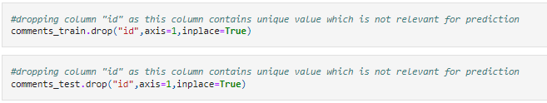
Data Cleaning
Dropped irrelevant column from both dataset that is “id” column as it contains unique value.

Slide 8


Data Description of Train Data-set
The dataset contains 159571 records (rows) and 8 features (columns).
After removal of irrelevant feature, and also after pre-processing, we get 159571 records (rows) and 11 features (columns).

Slide 9


Data Description of TEST Data-set
153164
The dataset contains 153164 records (rows) and 2 features (columns).
After removal of irrelevant feature, and also after pre-processing, we get 153164 records (rows) and 3 features (columns).

Slide 10
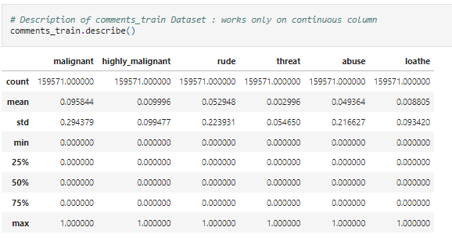
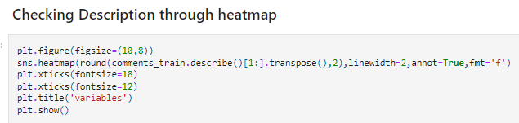
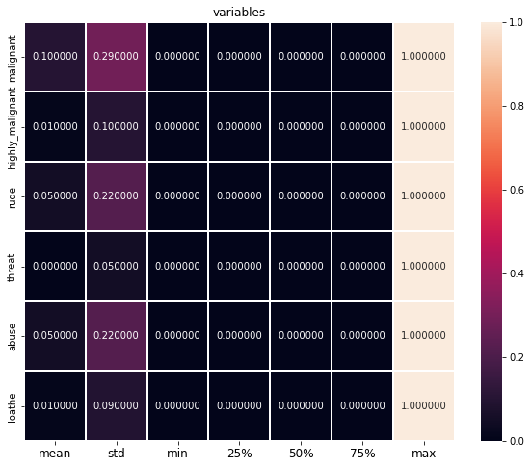
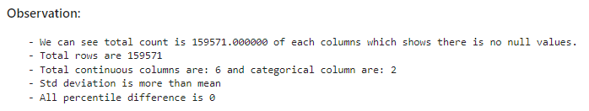
Data-Set Description

Slide 11
Data Visualization
Univariate Analysis Using Count-plot 2. Bivariate Analysis (for comparison between two features) Using Bar-plot 3. Multivariate Analysis Using Pie-plot (comparison between all features) Using Pair-plot (comparison between all features)

Slide 12
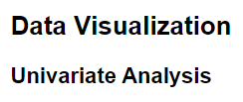







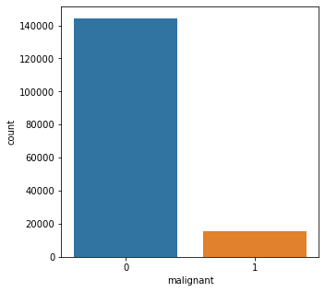
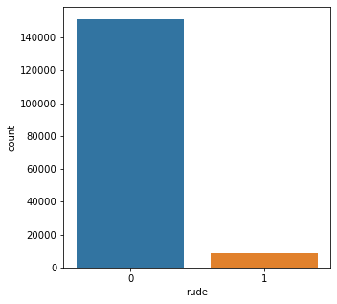


Slide 13


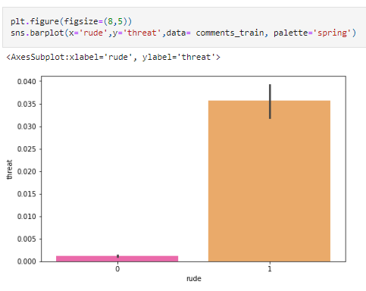
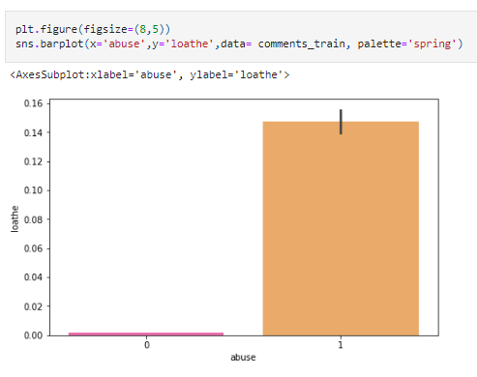

Slide 14

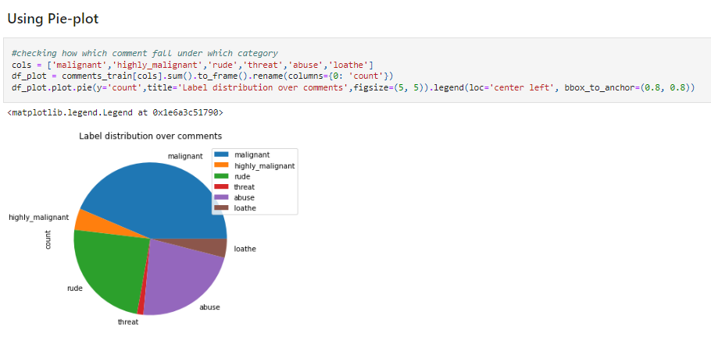

Slide 15


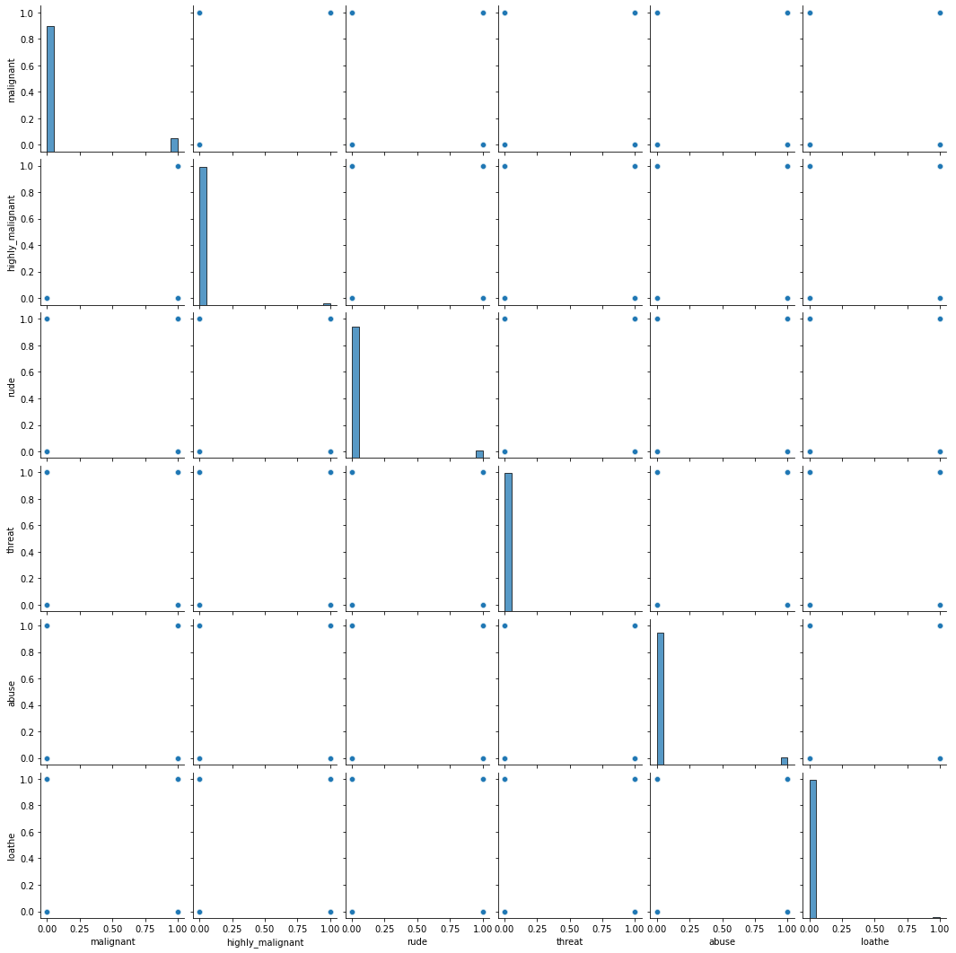


Slide 16
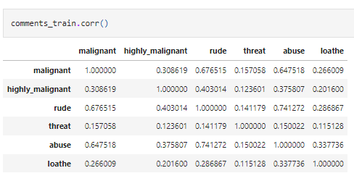
Checking Correlation
Correlation is checked for relation between features. Also Checked through Visualization (HeatMap)

Slide 17
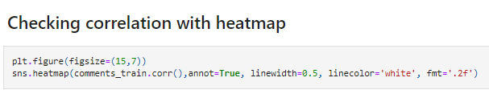
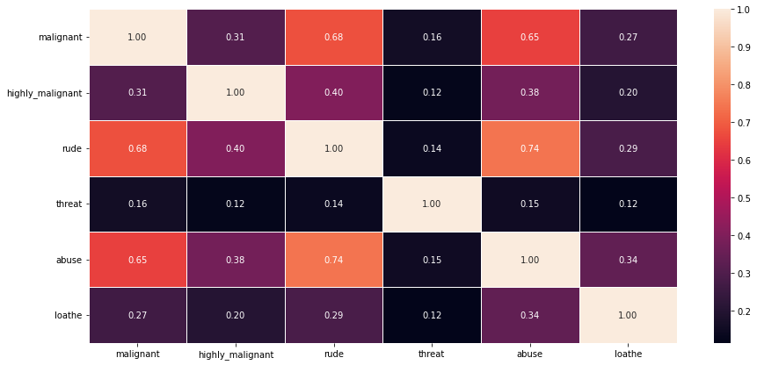

Slide 18
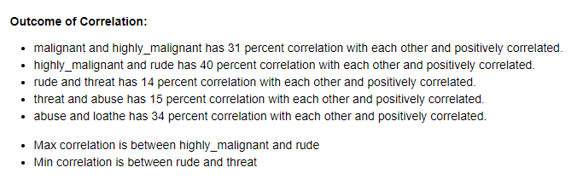

Slide 19


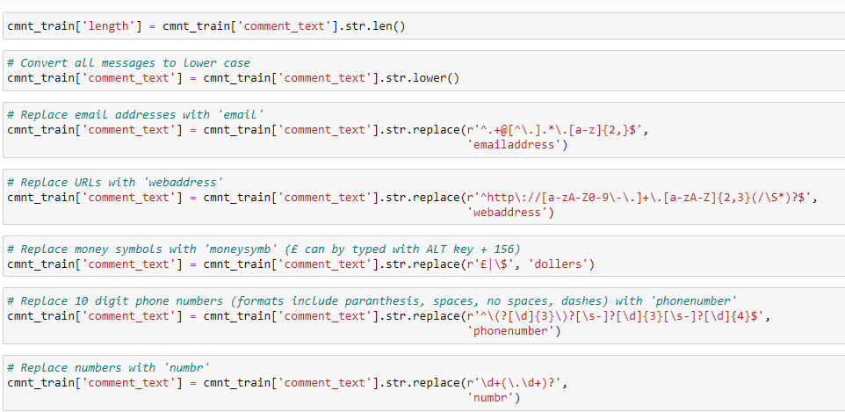

Slide 20
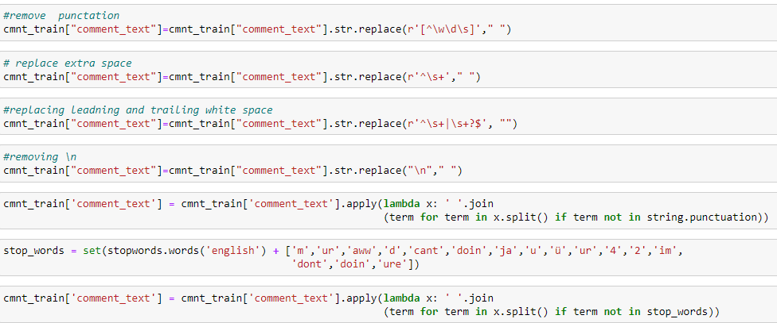

Slide 21
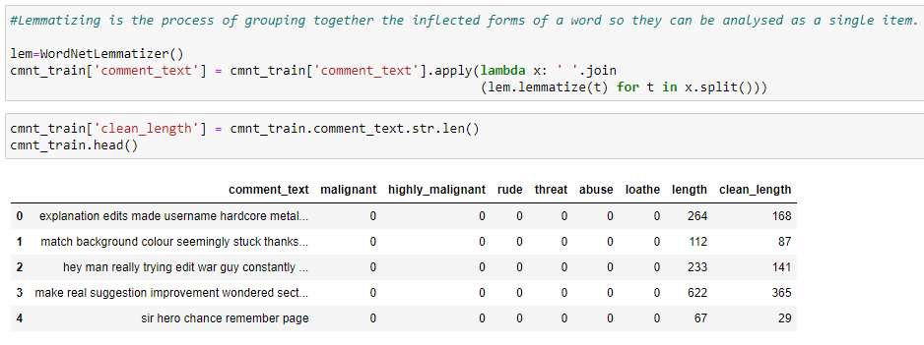
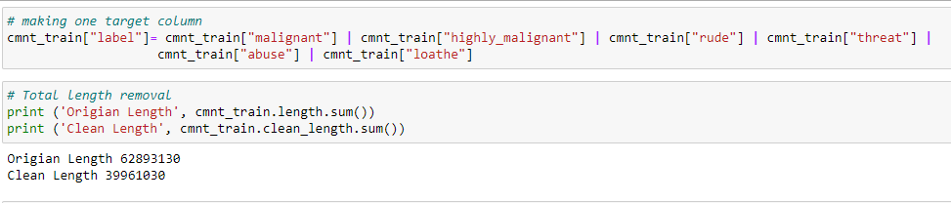

Slide 22
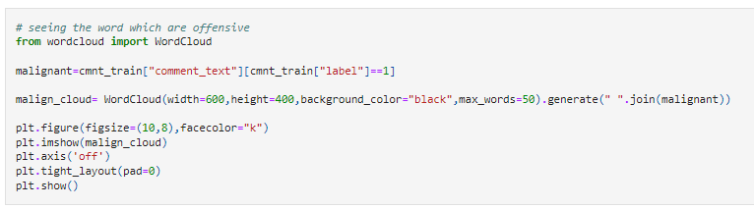
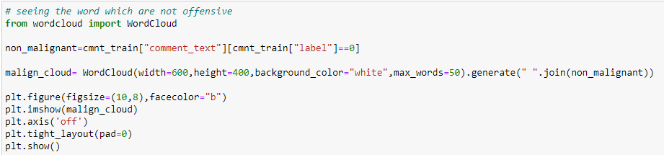
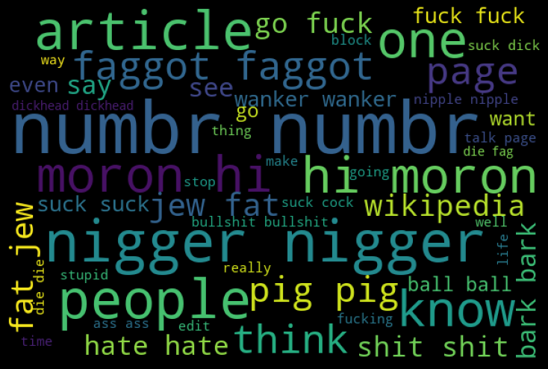
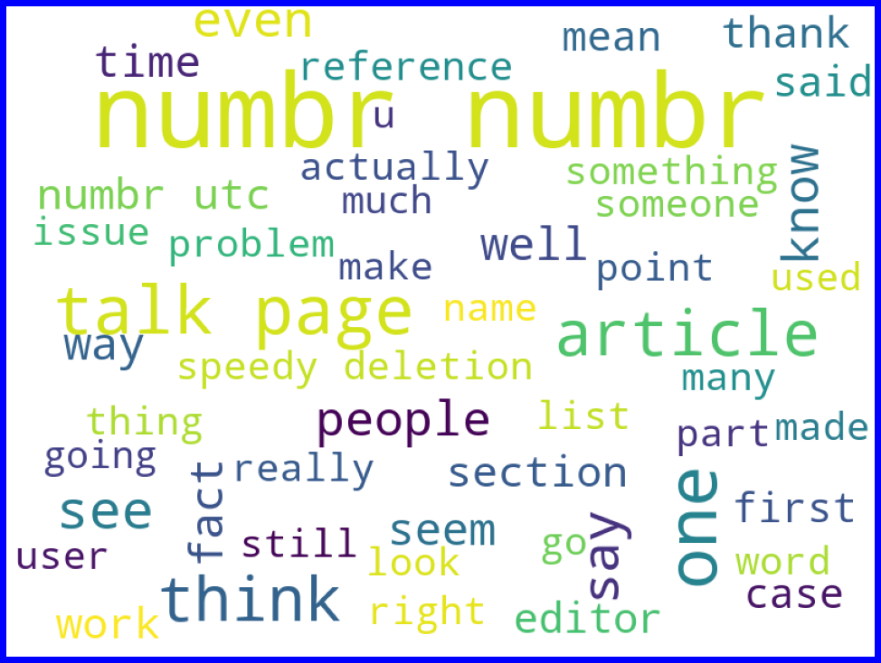

Slide 23
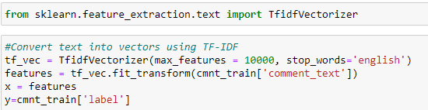
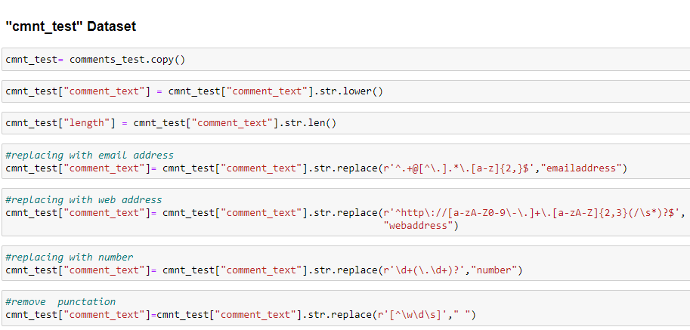

Slide 24
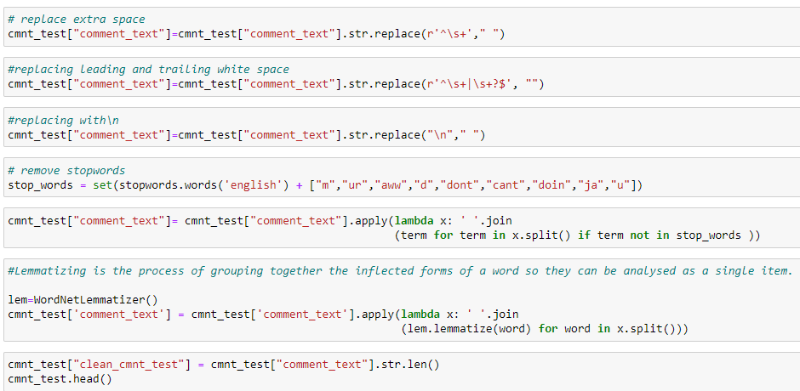
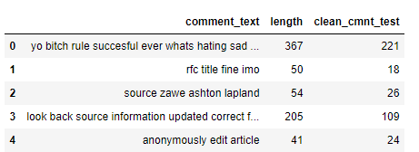
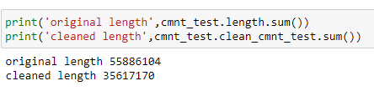

Slide 25
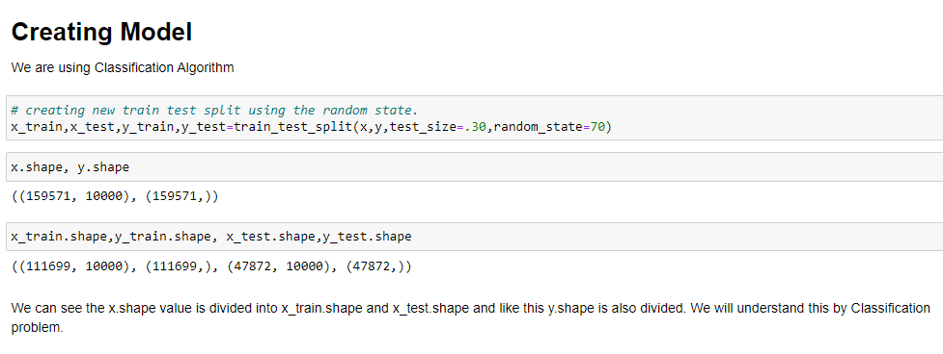

Slide 26
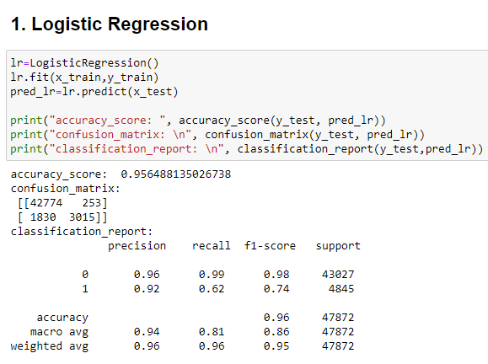

Slide 27
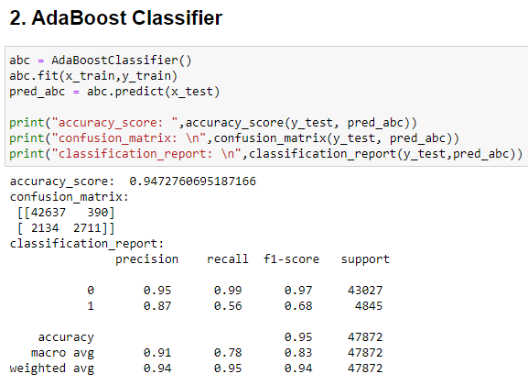

Slide 28
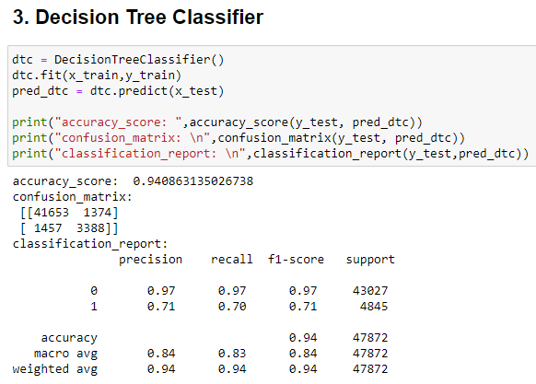

Slide 29
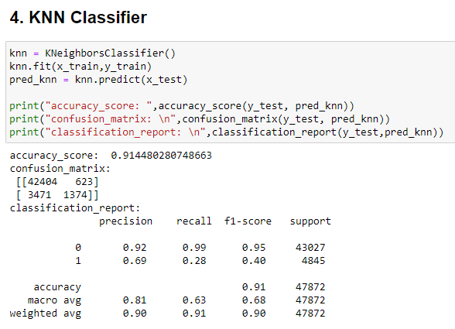

Slide 30
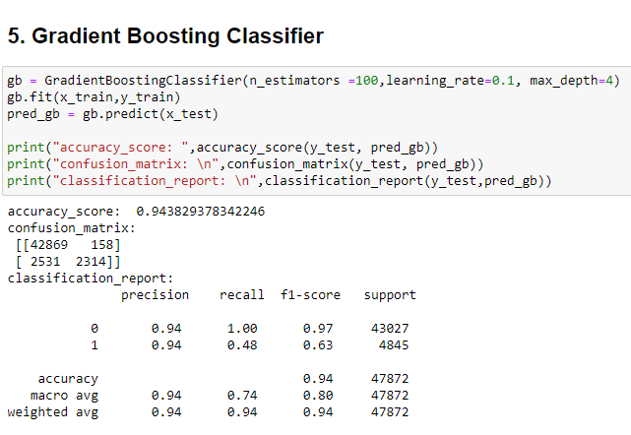

Slide 31
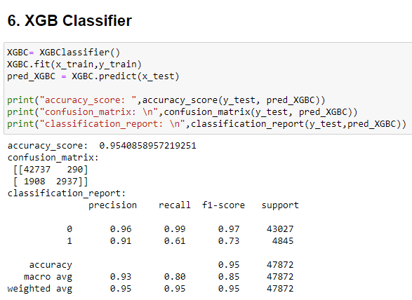

Slide 32
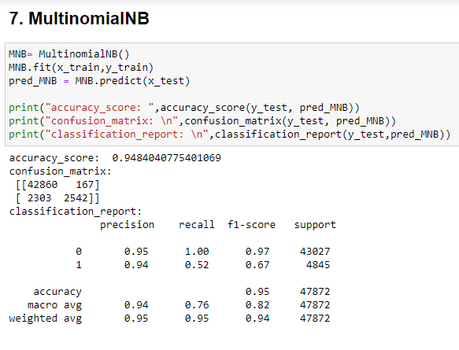

Slide 33
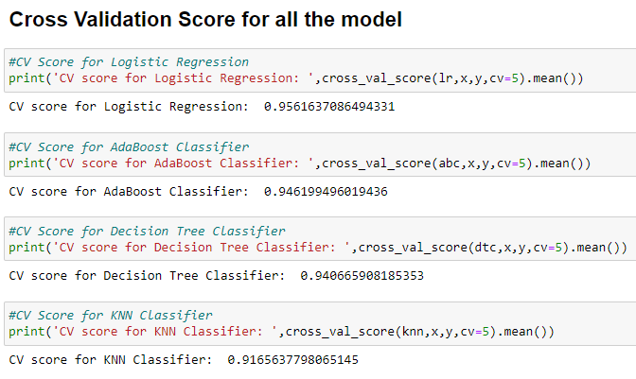
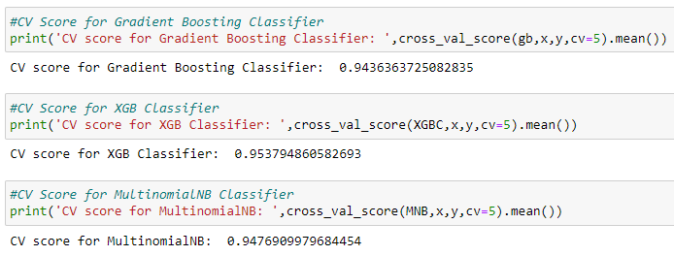

Slide 34
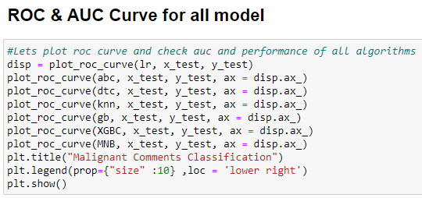
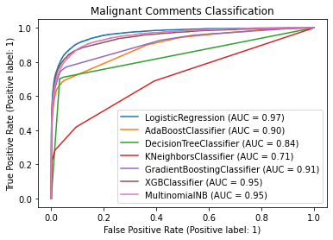

Slide 35
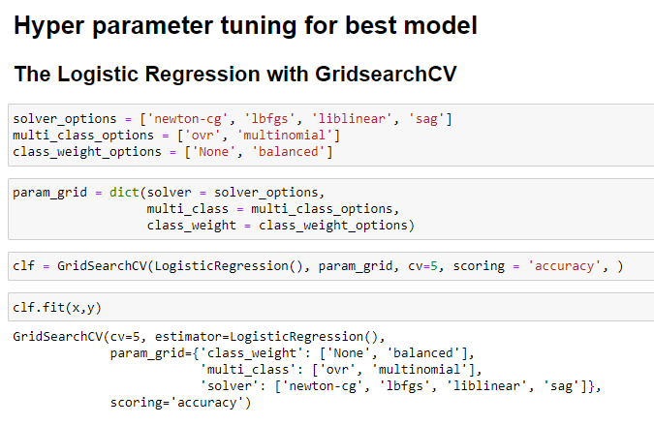
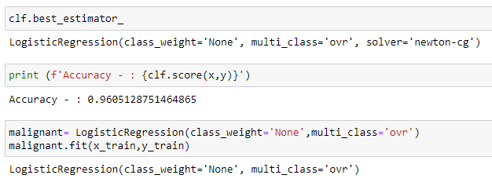

Slide 36
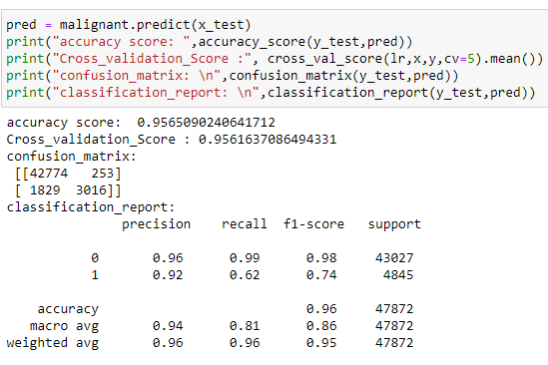
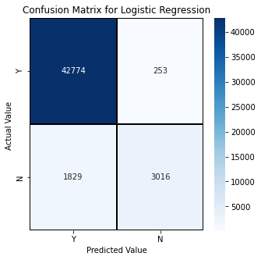
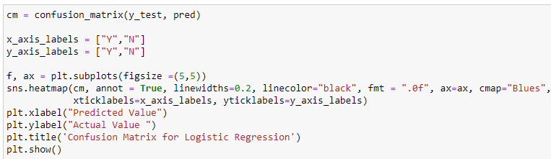


Slide 37
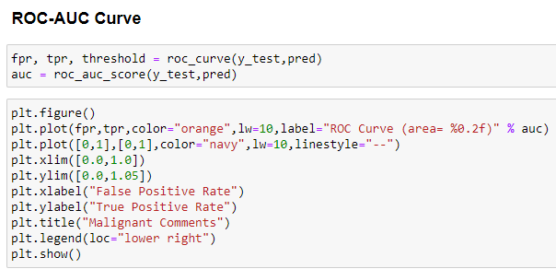
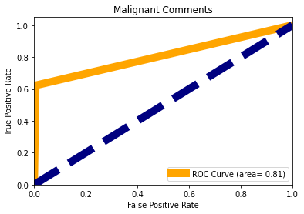

Slide 38
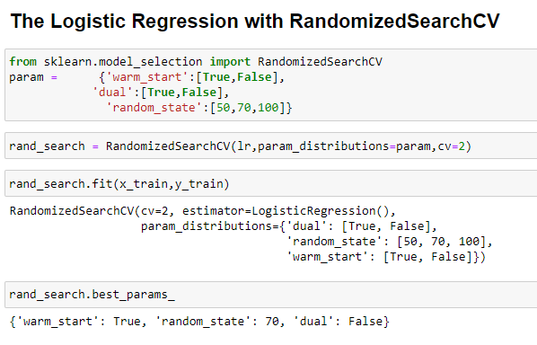
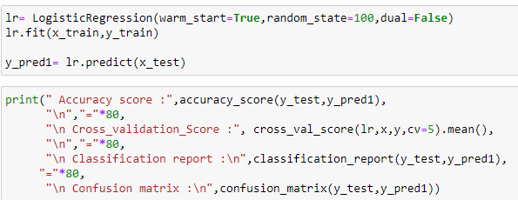


Slide 39






Slide 40


Final Procedure: 1. Saving the model 2. Comparing Actual and Prediction
40

Slide 41


3. Saving the model in CSV format
41

Slide 42
42
SUMMARY
This research work focuses on developing a model that would automatically classify a comment as either malignant or non-malignant using logistic regression. Therefore, this study aims to develop a multi-headed model to detect different types of malignant comment like threats, rude, abusive, and loathe. By collecting and pre-processing malignant comments for training and testing using term frequency- inverse document frequency (TF-IDF) algorithm, developing a multi-headed model will detect different types of malignant comment using logistic regression to train the dataset, and evaluate the model using confusion metrics

Slide 43
THANK YOU

